Slide 1
Plm domain

Slide 2
introduction
PLM Domain specification supports key RESTful web service interfaces for Product Lifecycle Management systems
Client
PLM Domain consumes services exposed via Requirement, Architecture, Change and Quality/test, PLM domain
Note: PLM – PDM or PLM-PLM to create links and persist data on the other side
Truck PLM system owns a Part used by Construction business PLM system
A CAD Model in PLM 1 can create a Part in PLM 2
One PLM system to manage Parts and PLM 2 for managing Manufacturing objects or CAD Data
Server

Slide 3
Oslc plm server

Slide 4
Resources (Support soft types for all objects types and each with specific constraints)
Parts
CAD Model (EPM Documents)
Documents -
Specifications
Standards
Structure (Usage and Occurrences : part & Usage: CAD Model)
Parts
CAD Models
Documents
Manufacturing process Plan
Standard Control Characteristics : engineering and manufacturing characteristics
Process Resources
Change Requests, Change Notices, Problem Reports, Quality domains etc.

Slide 5
terminologies
Document: Manage and share content that has been created using an external application
Problem Report: created to document a problem or request a product enhancement
Change Request: created in response to one or more problem reports, details the changes necessary to correct the problem or provide the enhancement so that the appropriate people can make the business decision to proceed with or cancel the proposed change
Change Notice: represents a work authorization to resolve a problem, often identified by an approved change request
Variance: an authorization to depart from the as-designed configuration for a specific number of units and or for a specified time period

Slide 6
Relationships to other resources
Part – Part
Part – Document (provide examples)
Part – CAD Document
Part – Change objects (Change requests, Change notices, deviation, etc.)
Part – Quality objects
Part – Standard Control Characteristic (Provide examples)
Manufacturing Process Plan - SCC

Slide 7
terminologies
Standard Control Characteristics: ffunctional features, geometrical or material properties, that can be qualified, measured, or quantified and for which variation or deviation control is necessary.

Slide 8
properties
Attributes on Part (Identity)
Attributes on Usage Link
Link models
Standardized approach to reverse lookup

Slide 9
operations
Discovery of PLM objects via service Provider (Products, projects, programs)
Creation Factory
Create CAD Data and Parts
Query Capability
Delegated UI Dialog
Previews
Pagination
Requesting a subset of oslc selected properties
Multi level link navigation (Part – CAD – Change)
Authentication
Basic
OAuth

Slide 10
PLM as a resources

Slide 11
parts
Ability to link a requirement/model Items to a Component Part
Component Part represents the Part Master within Windchill. The URI will point to the latest version reference for each view but will always return the latest revision details.
The latest design (Part version) satisfies the original requirement.
Ability to link a requirement to a Versioned Part
Versioned Parts will represent the latest revisions of a component Part
A specific released version of a part allocated to a certified requirement

Slide 12
terminologies
Version = Revision . Iteration
Version = A.1
A = Revision
1 = Iteration

Slide 13
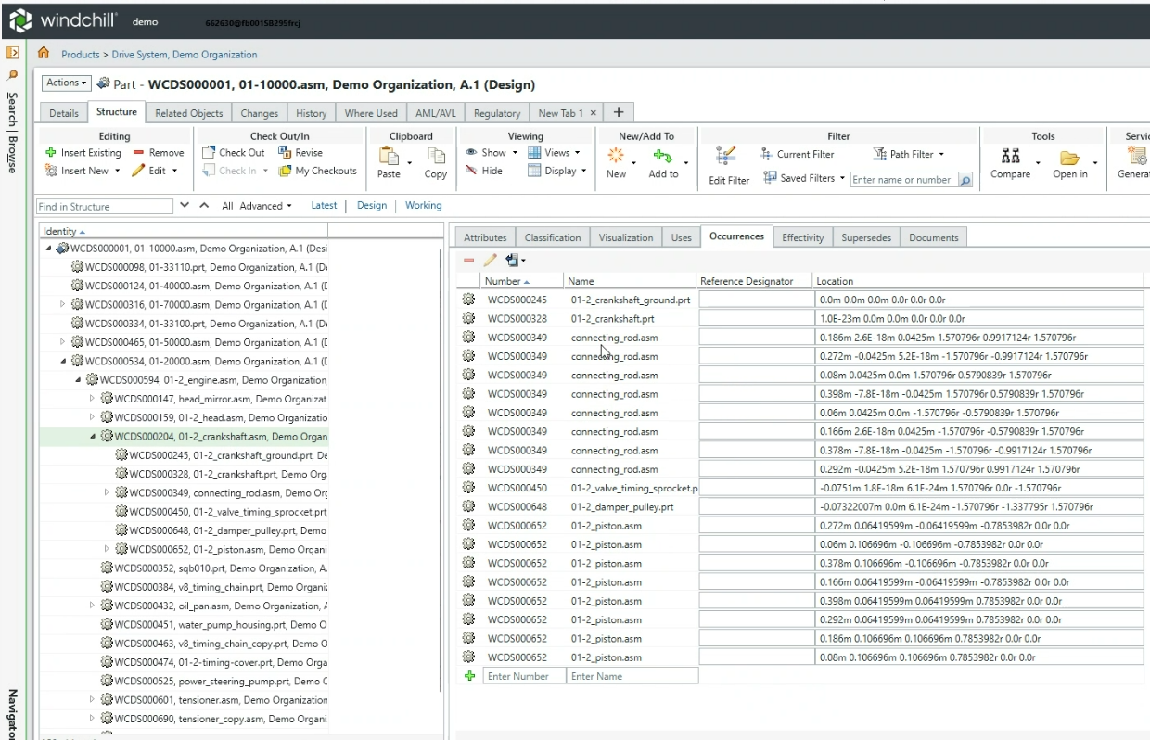




Ability to link a requirement to a Part Usage
Requirement: "Bracket must support 50 kg static load.“
Part Usage: Bracket used in the heavy-duty configuration.
Ability to link a requirement to a Part Occurrence
Requirement: "Tyre must maintain a pressure of 35 PSI when used on front-left axle under 800 kg load.“
Part: Radial Tire – Model T1000
Part Occurrence: The pressure requirement applies specifically to the front-left axle

Slide 14












Slide 15
quote styleS
“
“
Quote
Quote
Name Title, Company
Name Title, Company
logo
logo

Slide 16

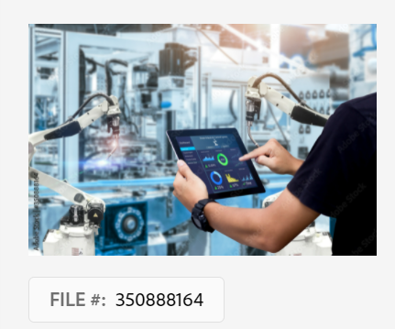
Ptc imagery
Avoid using too much text and/or too many icons throughout your presentation. Although sometimes icons get the message across, they can be cumbersome and slightly impersonal. An element of PTC’s new campaign initiative is to “humanize the brand.” Whenever possible use imagery. The right image can show PTC products in the real world and people relating to them.
Steps for licensing an image
Search for an image on https://stock.adobe.com Click on the image to get the image number (underneath in the left corner)
Email the image number to PPTSteward@ptc.com
Image will be retrieved from the subscription, and emailed back to you (at no cost to you)
Turn around time is 24-48 hours depending on time of year (preferred amount is aprox. 5 images per day)
If you own an adobe account you may be able to access the images
NOTE: Adobe images are for PPT presentations only

Slide 17


Image style
Correct
Imagery can be a powerful creative tool that helps us to protect PTC as a modern tech brand. It can reveal the excitement and energy of discovery and transformation.
When possible let photography communicate the benefit of technology to the audience.
Incorrect
Avoid dated “tech typography” poorly executed stock concepts, trite metaphors, posed model photos, and images with non PTC icons.
Images that convey real-world to digital transformation
Industry relevant images
People engaging with relevant technology
Choosing stock imagery is subjective but improper use of stock can quickly date, cheapen, or poorly communicate the brand.

Slide 18


Images ARE CONENT AND CAN HELP TELL A STORY

Slide 19




Images ARE CONENT AND CAN HELP TELL A STORY

Slide 20
Ptc icon library
This library contains OFFICIAL PTC ICONS to be used across ALL PRESENTATIONS for brand consistency.
Avoid using icons you find elsewhere as they are likely not on brand and without legal usage rights.
Use this library while creating slides then delete the pages. These icons are always at your fingertips while working on a presentation by choosing “file / new / default theme ” in PPT.

Slide 21























PTC ICONS
Core Segments
CAD
ALM
PLM
IOT, IIOT
SLM
AR
Computer Aided Design
Application Lifecycle Management
Product Lifecycle Management
Internet of Things Industrial Internet of Things
Service
Augmented Reality
Industry Verticals
Industrial
High Tech
Automotive
FA&D
Energy
Med Dev
Machine, Robot Arm
Digger
Aerospace & Defense, Satellite
Aerospace & Defense, Rocket
Wind Turbine
Oil Rig
MRI
Life Sciences
Genetic
Assembly Line
Process Industry
Aviation Defense Industry
Retail
Retail, Shopping Cart
Tag, Price
Sell, Buy
Concepts
Digital Twin
Digital Thread
Engineering Digital Thread
V-Model (ALM)
Agile / Velocity (ALM)
Agile / Sprints (Onshape)
SaaSIFY PTC

Slide 22




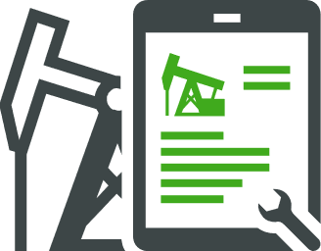















PTC Icons
SLM Asset System of Record
Industrial
FA&D
Electronics & High Tech
MedTech
Automotive
Energy
Service
Maintenance Manager
Service Technician Remote
Field Technician
Toolbox
Gears
Gear Cycle
Workflow
Gear settings
Wrench
Arbortext
Architect
Content Dev
Editor
Layout Dev
Layout Editor
Print Composer
Publishing
Styler

Slide 23






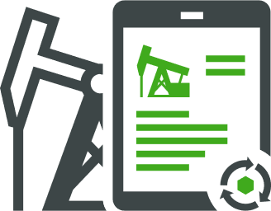



PTC Icons
Asset System of Record (General – PLM)
Industrial
FA&D
Electronics & High Tech
Industrial
MedTech
Automotive
Energy
Intelligent Product Life Cycle
Product (General)
Industrial
FA&D
Electronics & High Tech
MedTech
Automotive
Energy

Slide 24
























PTC Icons
People
User person
Group
Default person
Follow
Remove User
Admin
Customer Success
Construction worker
Employee Experience
Leadership
Support
Webinars, Events
Design
Administrator CAD
Administrator PLM
Attracting the best
Value Workshop
Person AR
Controls Engineer
Design Engineer
Architect Solutions
Group of Students
Educator and Student
Developer IOT
Manufacturing Executive
Network Administrator
Customer Facing
Supervisor
Systems Administrator PLM
Systems Administrator
Automation Process Engineer
Engagement Culture
Talent Retention
Group Hand Click
Requirements Management
Collaboration
Customer Service/Success
Worker shortages
Augmented Workforce
Construction

Slide 25





































PTC ICONS
Technology
Cloud
Cloud, Wifi, Connected
PTC Cloud
Software Development
3D Product
Simulation
Visual Simulation
Design Alternative
Digital Disruption
Wifi
Software Modeling
API
Automated Code Synchronization
Source Code Management
Calibrate
ERP
Linked Data
Embedded Software
Model-Based System
Brain
Chip and Search
Chip, Digital Product
Server
Explode view
Actuator
IT Security
Versioning
Templates
Customization
Artificial Intelligence
Machine Learning
App Switcher
Eyedropper
Thermometer
Protected Network
Global Network
Formula
Database
Automation

Slide 26
























PTC ICONS
Manufacturing / Production
Expand, Scale
Scalable
Recent Activity
Resize
Product
Supply Chain
Release Management
Gauge, Screening Levels
Product Line Management
Additive Manufacturing
Filtration, Funnel, Throughput
Risk Management
Risk Matrix
Performant
SAFe
Validation
Compliance
Design Alternate
Factory
Productivity
Variability Modeling

Slide 27


































PTC ICONS
Business / Finance
Bar Chart, Variable, Growth, Increase, Decrease
Bar Chart Horizontal Variable
Line Chart, Reduced
Line Chart, Increased
Trend Driven Product
Analytics
Strategy
Risk Cost Pressures
Money, Pay
Asset Efficiency
Time
Time speed
Hand, Pay, Gratuity
Handshake
Enhanced Collaboration
City
Building
Time, Timing, Schedule
Accelerate
Exchange, Reassign, Reorder
Lifecycle, workflow
Connect
Target
Governance
Blog Contact
Workflow
Reduce Burndown
Transparency
Pie Chart
Operating Margin
Strategic Re-use
Data Process

Slide 28


























PTC ICONS
Devices
Magnify Glass, Search
Print
Laptop
Mobile Phone
Tablet, iPad
Tablet, iPad, User Placement
Desktop, On-Premise Applications, Variations
Gaming Console
USB
Binoculars
Video camera
Camera
Transportation / Environmental
Bus
Airplane
Bike
Pin, Map Marker
On Track
Current
Boat
Lightning
Leaf
Leaf Reduce Energy Consumption
Environment
Waste Management, Trash, Delete
Fire
Flower

Slide 29




































PTC ICONS
Symbols
Unlock
Lock
Unlink
Link
Sync
Recent, Update
Refresh
History
Eye, View
Invisible
World, Globe
Help, Questions, Request
Remove, Close
Info
Error, Alert, Warning
Hand, Show
Thumbs Up, Like
Thumbs Down
Hand, Pointing
More, Etc.
Add, Plus Sign
Minus
Notification Bell
Puzzle
Flag
Image
Download Image
Upload Image
Download
Upload
Export
Logout
Fullscreen Exit
Closed Caption
Arrows, Pointer
Arrows, Pointer
Chevrons
Drag
Save
Menu, Hamburger

Slide 30















































PTC ICONS
Office
Document Check
Paper, Document
3D Doc
Papers, Documents
Copy, Duplicate
Folder, Content Management
Clipboard
Active, Check, Checkmark, OK
Check, Checkmark, Requirements Mngmnt, Grant Access
Event
Calendar
Plan
Test Case
Innovation Creativity
Email
Send
Inbox
Assign
Backspace
Label
Lightbulb, Innovative, Gear
Quote
Shield
Report
Unarchive
Archive
Reorder, Bind
Gallery
Attach, Paperclip
Reorder
Badge
Record Breaking
Trophy
List, To Do, Agenda
Disclosure
Talk Bubble, Chat, Comment, Review Item
Bookmark
Erase
Key
Edit, Pencil, Pen Draw
Project Briefcase
Architecture

Slide 31


























PTC Icons
Education & People Team (HR)
Review
Lifelong learning
Graduation Cap
Backpack
Medical
First-aid
Star
Heart, Favorite
Home
Celebration
Cutlery, Social
Cocktail
Wine
Coffee Cup, Break
Drink
Fries
Hamburger
Headphones
Dumbbells
Hand, Pay
Benefits
Gift, Perks
Social Responsibility
Vacation
Volunteering
Work Life Balance
Crystal Ball
PTC Values icons
PTC Values icons
CUSTOMERS MATTER
TEAM PTC
BE BOLD
PTC FOR ALL
PURPOSEFULL INNOVATION
CUSTOMERS MATTER
TEAM PTC
BE BOLD
PTC FOR ALL
PURPOSEFULL INNOVATION

Slide 32



















PTC ICONS
Social Media
Share
Facebook
LinkedIn
Twitter
YouTube
Playlist
Google+
Poll
Media Play Buttons
Fast Forward
Rewind
Skip Right
Skip Left
Video, Play
Pause
Power Button
Stop
Speaker
Sound ON
Sound Off, Mute
Microphone
Fast Forward
Replay
Volume Up
Volume off

